Slide 1


Data Mining and Data Warehousing
CSE-4107
Md. Manowarul Islam
Assistant Professor, Dept. of CSE
Jagannath University

Slide 2
What Is Frequent Pattern Analysis?
Frequent pattern: a pattern (a set of items, subsequences, substructures, etc.) that occurs frequently in a data set
First proposed by Agrawal, Imielinski, and Swami [AIS93] in the context of frequent itemsets and association rule mining
Motivation: Finding inherent regularities in data
  What products were often purchased together?— Beer and diapers?!
  What are the subsequent purchases after buying a PC?
  What kinds of DNA are sensitive to this new drug?
  Can we automatically classify web documents?
Applications
  Basket data analysis, cross-marketing, catalog design, sale campaign analysis, Web log (click stream) analysis, and DNA sequence analysis.

Slide 3
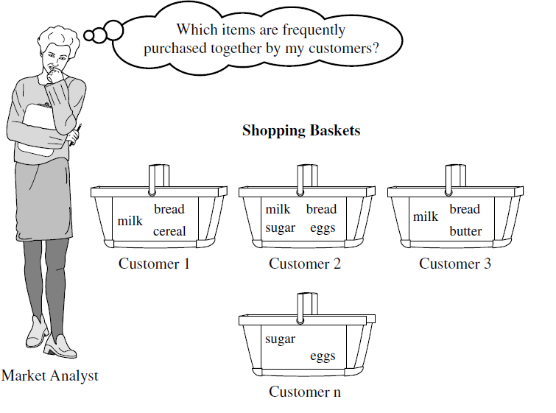
Market-Basket Data
A large set of items, e.g., things sold in a supermarket.
A large set of baskets, each of which is a small set of the items, e.g., the things one customer buys on one day.

Slide 4
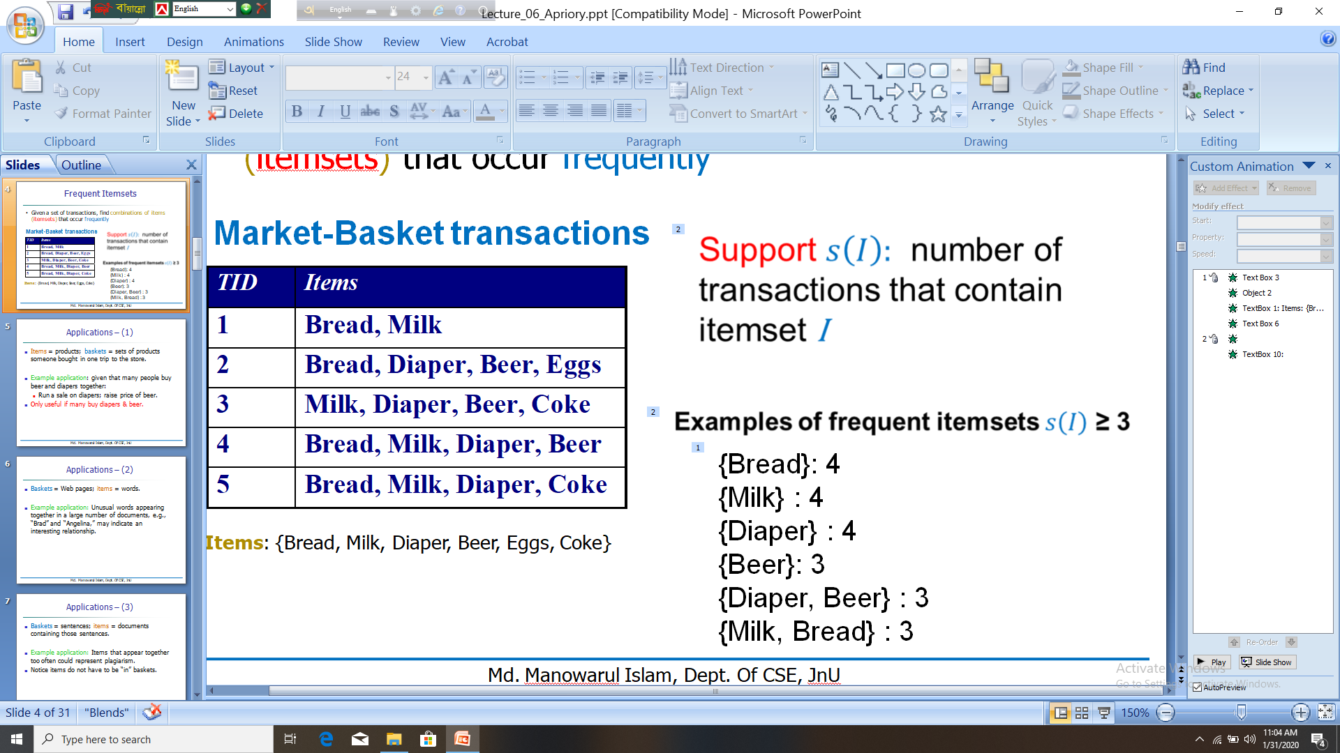
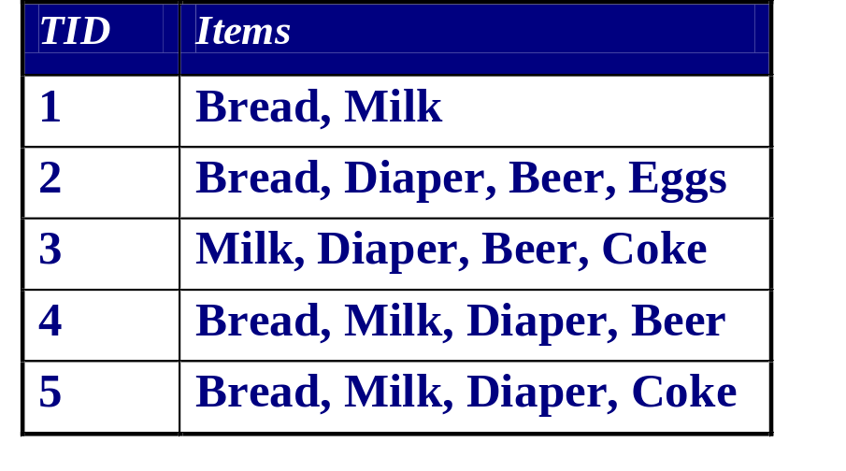
Frequent Itemsets
Given a set of transactions, find combinations of items (itemsets) that occur frequently
Market-Basket transactions
{Bread}: 4
{Milk} : 4
{Diaper} : 4
{Beer}: 3
{Diaper, Beer} : 3
{Milk, Bread} : 3
Items: {Bread, Milk, Diaper, Beer, Eggs, Coke}

Slide 5
Applications – (1)
Items = products; baskets = sets of products someone bought in one trip to the store.
Example application: given that many people buy beer and diapers together:
  Run a sale on diapers; raise price of beer.
Only useful if many buy diapers & beer.

Slide 6
Applications – (2)
Baskets = Web pages; items = words.
Example application: Unusual words appearing together in a large number of documents, e.g., “Brad” and “Angelina,” may indicate an interesting relationship.

Slide 7
Applications – (3)
Baskets = sentences; items = documents containing those sentences.
Example application: Items that appear together too often could represent plagiarism.
Notice items do not have to be “in” baskets.

Slide 8

Definition: Frequent Itemset
Itemset
  A collection of one or more items
    Example: {Milk, Bread, Diaper}
  k-itemset
    An itemset that contains k items
Support count (σ)
  Frequency of occurrence of an itemset
  E.g. σ({Milk, Bread,Diaper}) = 2
Support
  Fraction of transactions that contain an itemset
  E.g. s({Milk, Bread, Diaper}) = 2/5=40%
Frequent Itemset
  An itemset whose support is greater than or equal to a minsup threshold

Slide 9

Association Rule Mining
Given a set of transactions, find rules that will predict the occurrence of an item based on the occurrences of other items in the transaction
Market-Basket transactions
Example of Association Rules
{Diaper} → {Beer},
{Milk, Bread} → {Eggs,Coke},
{Beer, Bread} → {Milk},

Slide 10



Definition: Association Rule
Association Rule
  An implication expression of the form X → Y, where X and Y are itemsets
  Example:
  {Milk, Diaper} → {Beer}
Rule Evaluation Metrics
  Support (s)
    Fraction of transactions that contain both X and Y
  Confidence (c)
    Measures how often items in Y
    appear in transactions that
    contain X
Example:

Slide 11
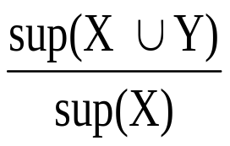
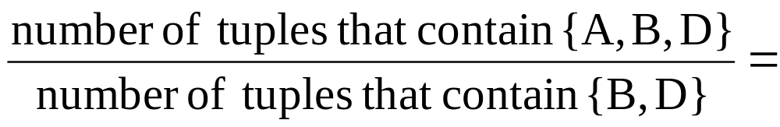
Example
TID date items_bought
100 10/10/99 {F,A,D,B}
200 15/10/99 {D,A,C,E,B}
300 19/10/99 {C,A,B,E}
400 20/10/99 {B,A,D}
Remember:
conf(X ⇒ Y) =
What is the support and confidence of the rule: {B,D} ⇒ {A}
Support:
  percentage of tuples that contain {A,B,D} =
75%
Confidence:
100%

Slide 12
Association Rule Mining Task
Given a set of transactions T, the goal of association rule mining is to find all rules having
  support ≥ minsup threshold
  confidence ≥ minconf threshold
Brute-force approach:
  List all possible association rules
  Compute the support and confidence for each rule
  Prune rules that fail the minsup and minconf thresholds
  ⇒ Computationally prohibitive!

Slide 13
Mining Association Rules
Example of Rules:
{Milk,Diaper} → {Beer} (s=0.4, c=0.67)
{Milk,Beer} → {Diaper} (s=0.4, c=1.0)
{Diaper,Beer} → {Milk} (s=0.4, c=0.67)
{Beer} → {Milk,Diaper} (s=0.4, c=0.67)
{Diaper} → {Milk,Beer} (s=0.4, c=0.5)
{Milk} → {Diaper,Beer} (s=0.4, c=0.5)
Observations:
All the above rules are binary partitions of the same itemset:
{Milk, Diaper, Beer}
Rules originating from the same itemset have identical support but can have different confidence
Thus, we may decouple the support and confidence requirements

Slide 14
Mining Association Rules
Two-step approach:
  Frequent Itemset Generation
    Generate all itemsets whose support ≥ minsup
  Rule Generation
    Generate high confidence rules from each frequent itemset, where each rule is a binary partitioning of a frequent itemset
Frequent itemset generation is still computationally expensive

Slide 15
The Apriori Principle
Apriori principle (Main observation):
  If an itemset is frequent, then all of its subsets must also be frequent
  If an itemset is not frequent, then all of its supersets cannot be frequent

Slide 16
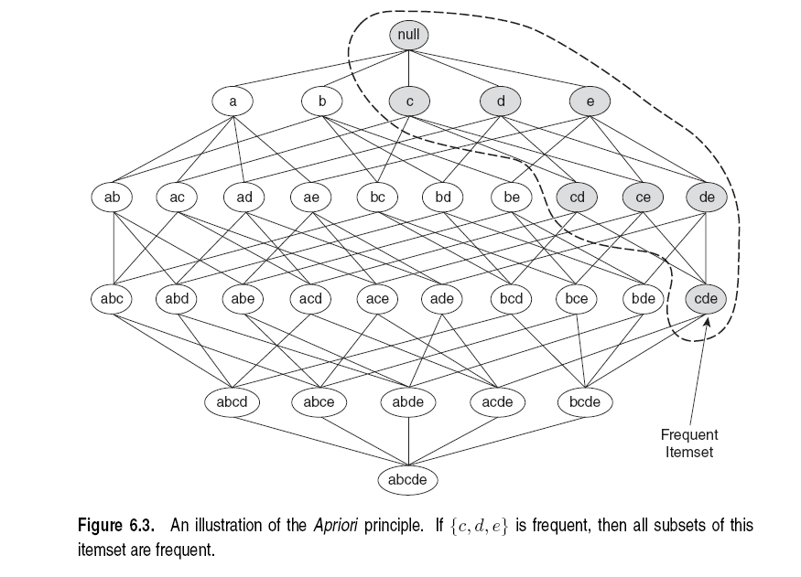
Illustration of the Apriori principle
Frequent subsets
Found to be frequent

Slide 17


Illustration of the Apriori principle
Found to be Infrequent
Infrequent supersets
Pruned

Slide 18
Apriori: A Candidate Generation-and-Test Approach
Apriori pruning principle: If there is any itemset which is infrequent, its superset should not be generated/tested! (Agrawal & Srikant @VLDB’94, Mannila, et al. @ KDD’ 94)
Method:
  Initially, scan DB once to get frequent 1-itemset
  Generate length (k+1) candidate itemsets from length k frequent itemsets
  Test the candidates against DB
  Terminate when no frequent or candidate set can be generated

Slide 19
The Apriori Algorithm—An Example
Sup_{min} = 2
Itemset | sup
{A} | 2
{B} | 3
{C} | 3
{D} | 1
{E} | 3
Database TDB
Itemset | sup
{A} | 2
{B} | 3
{C} | 3
{E} | 3
L₁
Tid | Items
10 | A, C, D
20 | B, C, E
30 | A, B, C, E
40 | B, E
C₁
1st scan
C₂
Itemset | sup
{A, B} | 1
{A, C} | 2
{A, E} | 1
{B, C} | 2
{B, E} | 3
{C, E} | 2
C₂
L₂
Itemset
{A, B}
{A, C}
{A, E}
{B, C}
{B, E}
{C, E}
Itemset | sup
{A, C} | 2
{B, C} | 2
{B, E} | 3
{C, E} | 2
2nd scan
C₃
Itemset
{B, C, E}
3rd scan
L₃
Itemset | sup
{B, C, E} | 2

Slide 20

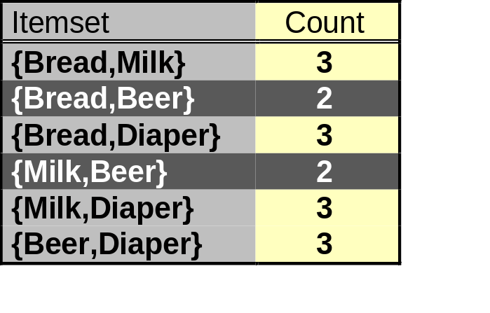
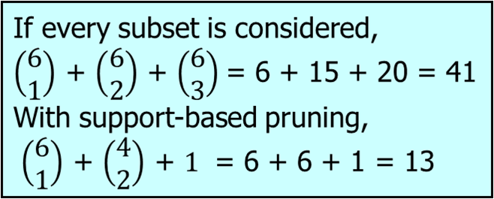
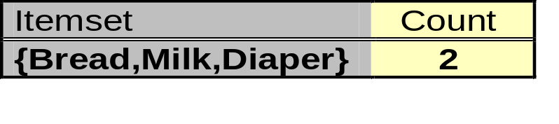
Illustration of the Apriori principle
minsup = 3
Items (1-itemsets)‏
Pairs (2-itemsets)‏
(No need to generate
candidates involving Coke
or Eggs)‏
Triplets (3-itemsets)‏
Only this triplet has all subsets to be frequent
But it is below the minsup threshold

Slide 21
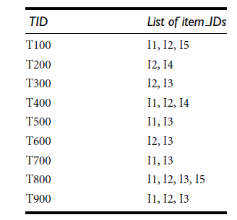
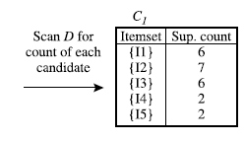
Apriori
Step 1: scans all of the transactions in order to count the number of occurrences of each item- C1

Slide 22
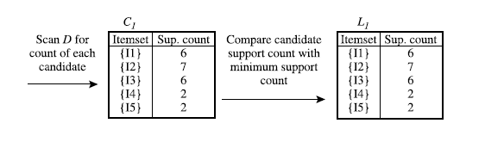
Apriori
Step 2: Determine the set of frequent 1-itemsets L1

Slide 23
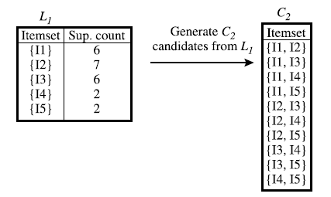
Apriori
Step 3: Generate C2- candidate 2-itemsets

Slide 24
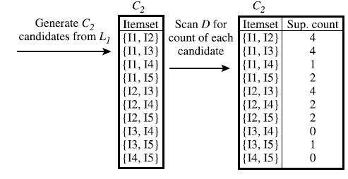
Apriori
Step 4: Generate C2- candidate 2-itemsets and scan the database

Slide 25
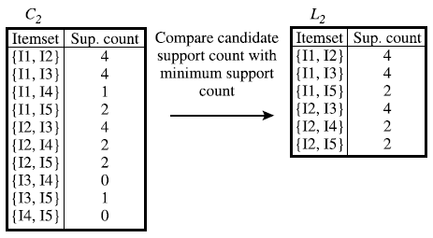
Apriori
Step 4: Determine the set of frequent 2-itemsets L2

Slide 26
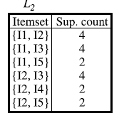
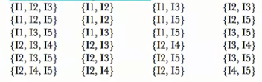
Apriori
Step 5: Generate C3- candidate 3-itemsets (pruning)

Slide 27
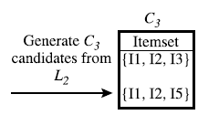
Apriori
Step 5: Generate C3- candidate 3-itemsets (pruning)

Slide 28
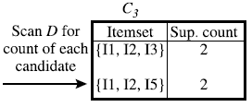
Apriori
Step 5: Generate C3- candidate 3-itemsets

Slide 29
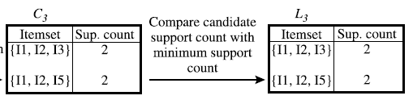
Apriori
Step 6: Determine the set of frequent 3-itemsets L3

Slide 30
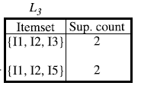
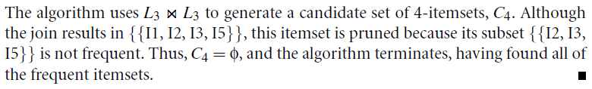
Apriori
Step 7: Determine the set of frequent 3-itemsets L3

Slide 31
Thank you

